Slide 1
Simple Actions on JetHexa

Slide 2
Simple Actions
In the Previous demonstration, Intro to JetHexa, we showed how actions can be performed through the HiWonder App
In this demonstration, we will show how those actions are actually programmed into the computer

Slide 3
What are Actions
An Action to a robot is nothing more than a list of discrete, and in-order instructions that the robot is going to follow
These instructions tell the robot exactly how to move a certain part, such as a servo
For example, to tell a two-legged robot to take two steps:
Lift right leg up off the ground
Move right leg forward
Lower right leg to the ground
Lift left leg up off the ground
Move left leg forward
Lower left leg to the ground
Simple example, and we are leaving out parts for how each joint should move, but you can see how this can get very complicated

Slide 4
What are Actions
On the JetHexa, we don’t just have two legs though, we have six legs, with each leg having three servos, or joints to deal with
Luckily, there is a JetHexa Application Programming Interface (API) that will take care of much of the work for us, but we still have to program in certain attributes

Slide 5
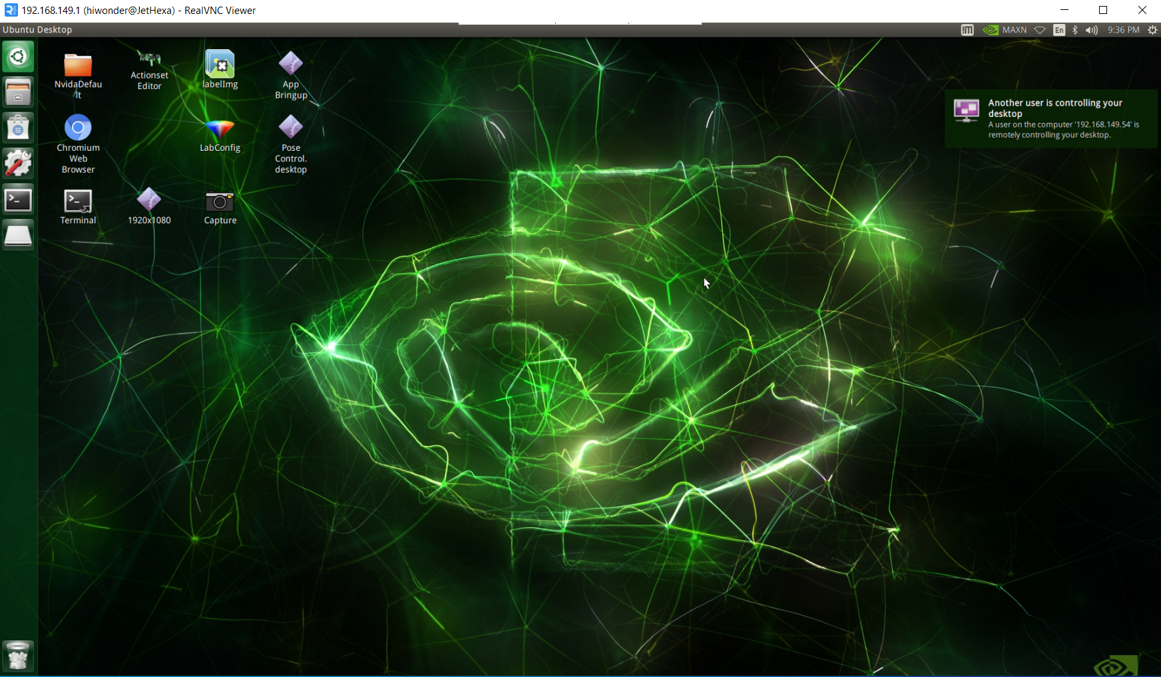
Connect to the JetHexa
You should still be connected to the JetHexa through VNC, but if not, follow the last demonstration and reconnect to the device

Slide 6
Terminal
Double click on the terminal icon

Slide 7
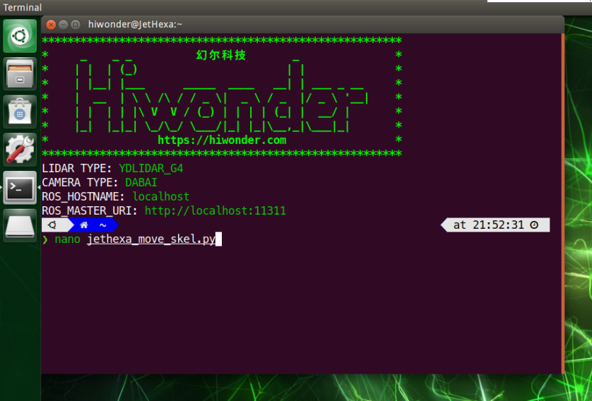
Edit the Code
Type in the following command into the terminal to edit the file, then press enter
“nano jethexa_move_skel.py”

Slide 8
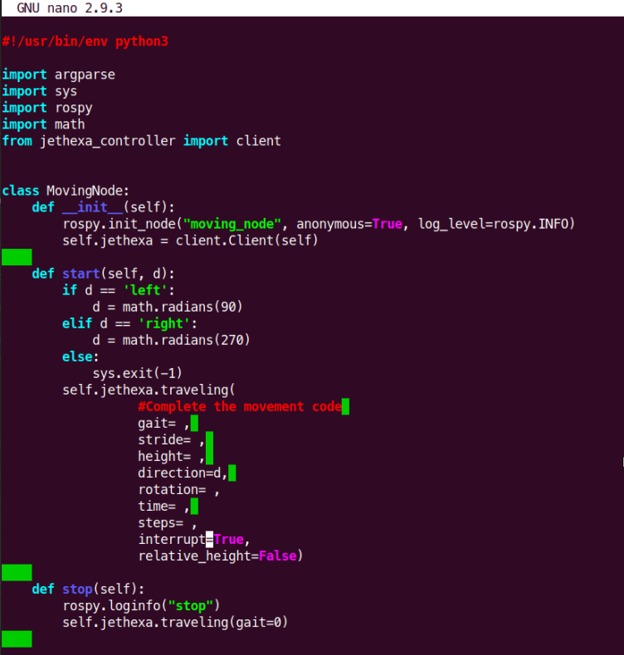
Edit the Code
You will see the skeleton code appear in the terminal
Click the icon in the top left corner to make the terminal larger

Slide 9
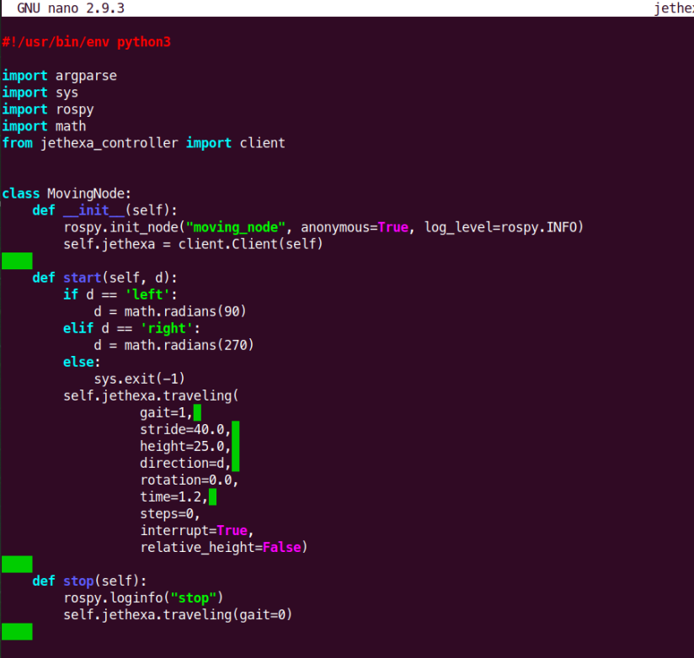
Edit the Code
Edit the skeleton code to look like the code below
Then save the file by pressing “CTRL+X” -> “Y” -> “Enter”

Slide 10
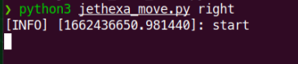
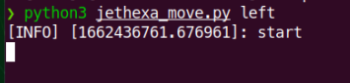
Running the Code
When running the code, you can specify whether to have to robot move to the right or to the left
To move right:
“python3 jethexa_move.py right”
To move left:
“python3 jethexa_move.py left”

Slide 11
Running the Code
After trying out both version of the code, you can try editing the values we specified and seeing how that effects the robots movement

Slide 12
Analysis
You should now be able to see how actions can be programmed into the device by specifying different attributes for how the robot should move

Slide 13
Next Up
JetHexa with Haar Cascade

